Slide 1
Diabetic patients Dataset
Python for Data analysis
Imen OULED DLALA
By: Arnaud DE BRITO
Nicolas FERRARA
Constance LE FOURN

Slide 2
Problematic:
How to predict the readmission of diabetic patients
Libraries used:
-Numpy
-Pandas
-Matplotlib
-Seaborn
-Scikit-learn

Slide 3
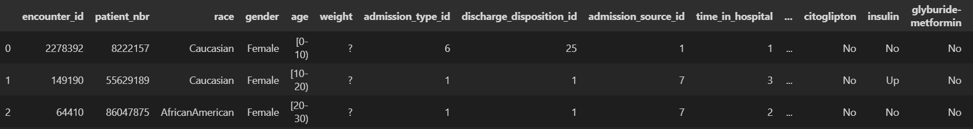
Data preprocessing:
Let’s have a look to our data:

Slide 4
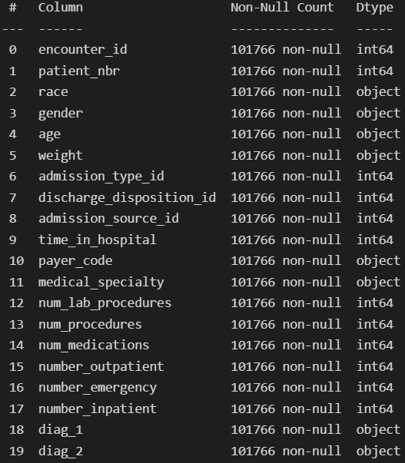
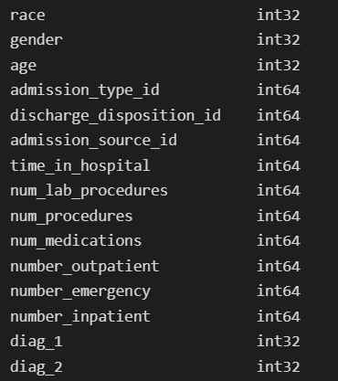
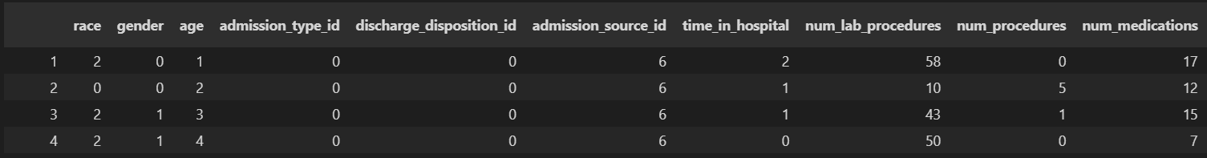
Data preprocessing:
Then we have cleaned up the dataset.
It includes encoding, dropping NaN and duplicates values.

Slide 5
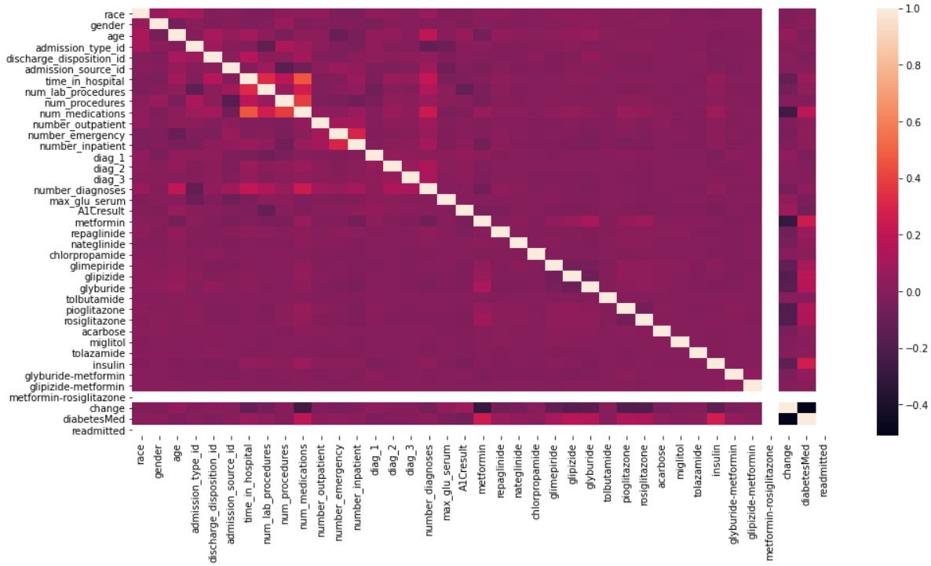
Data preprocessing:
The last step is the heatmap of the correlation matrix to find links between variables.

Slide 6
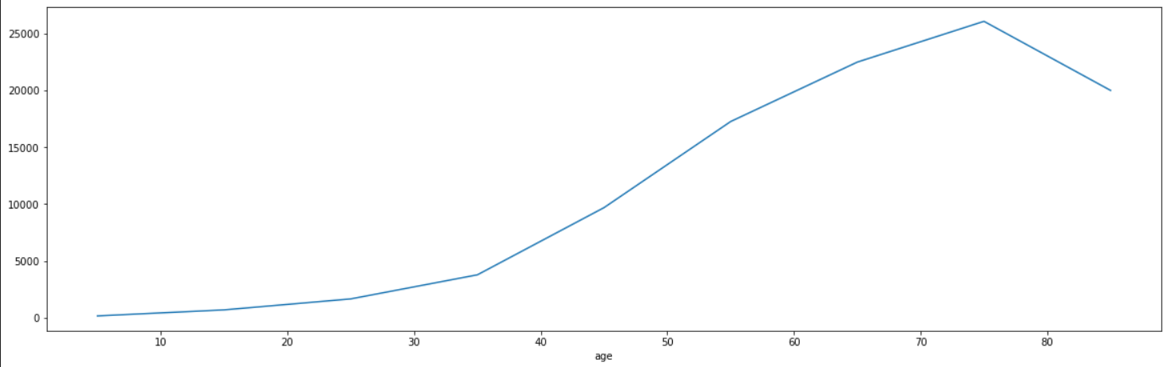
Data visualization:
First let’s have a look to the number of diabetic people depending on their age:

Slide 7
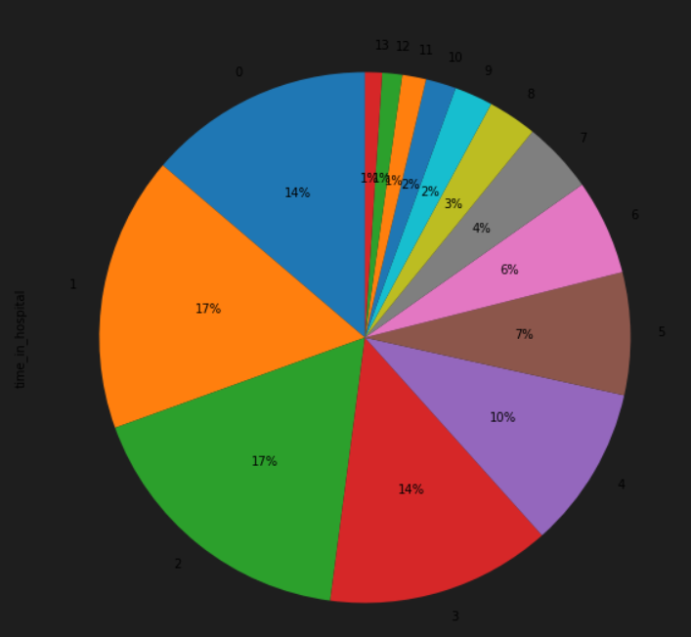
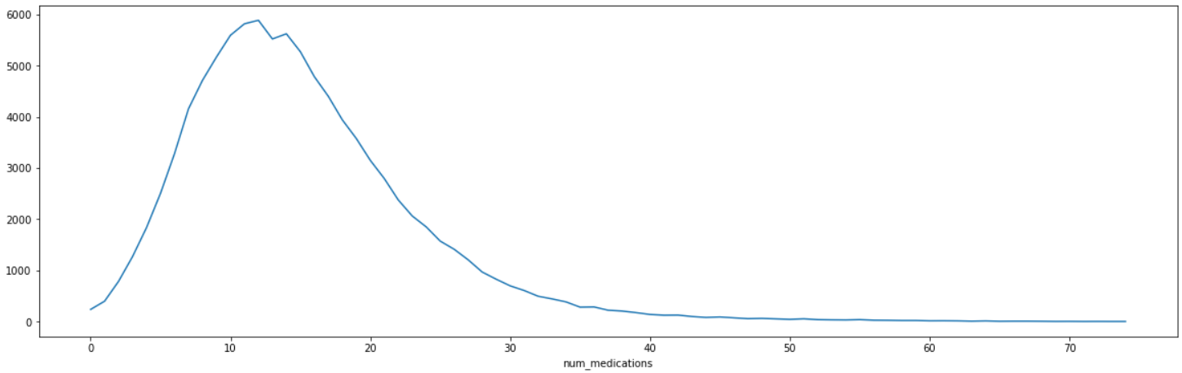
Data visualization:
Then, we have a repartition of patient time at the hospital (in days):
And a repartition of the medication they take during their stay:

Slide 8
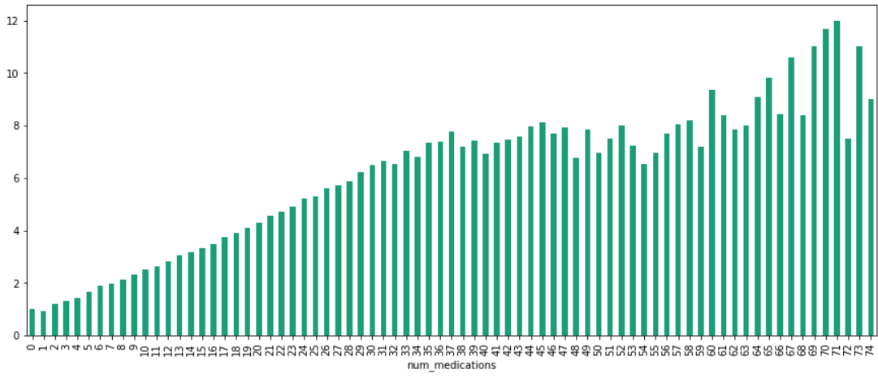
Data visualization:
The last visualization is a representation of the time in hospital in function of the medication they take:

Slide 9
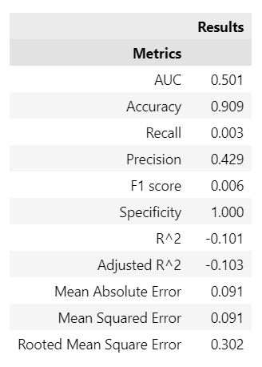
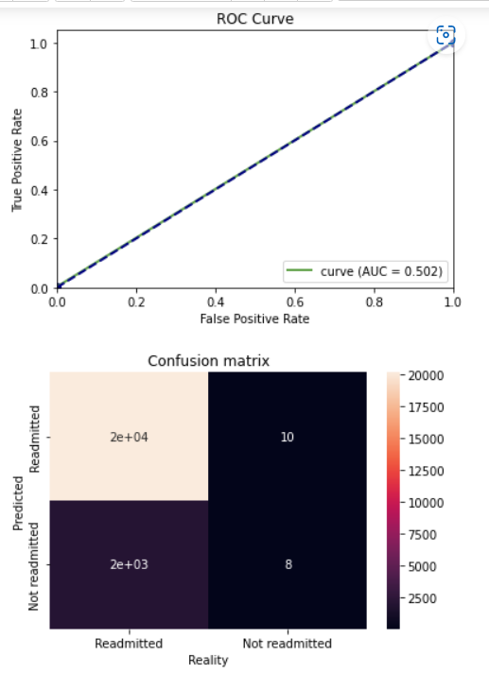
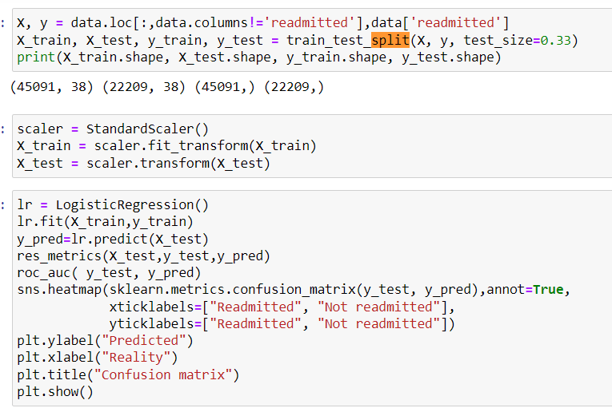
Modeling:
First results with a logistic regression

Slide 10
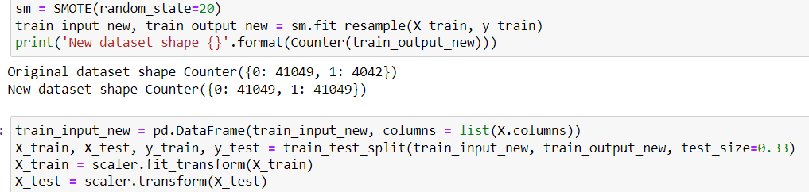
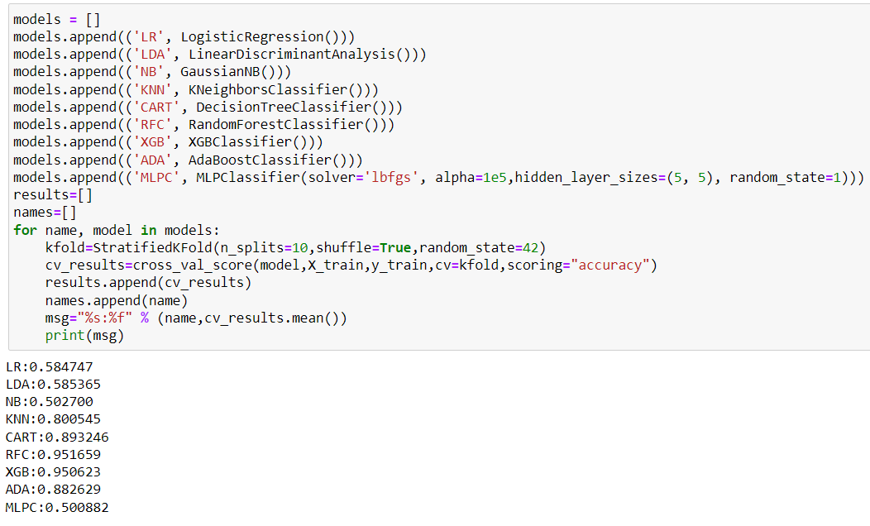
Modeling:
Modification of dataset and Models Benchmark

Slide 11
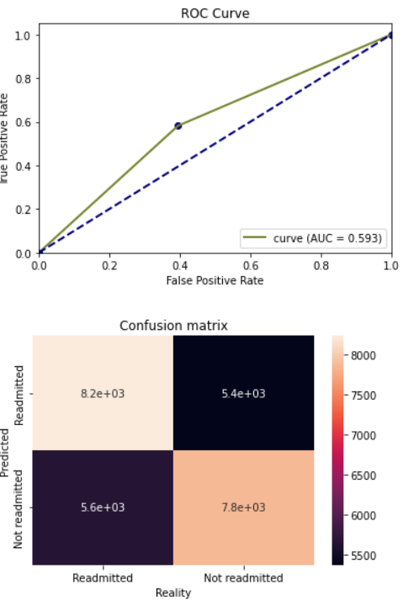
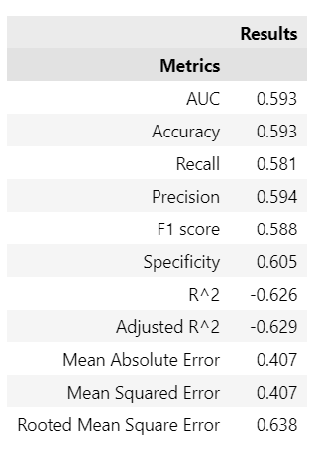
Modeling:
Second results with a logistic regression

Slide 12
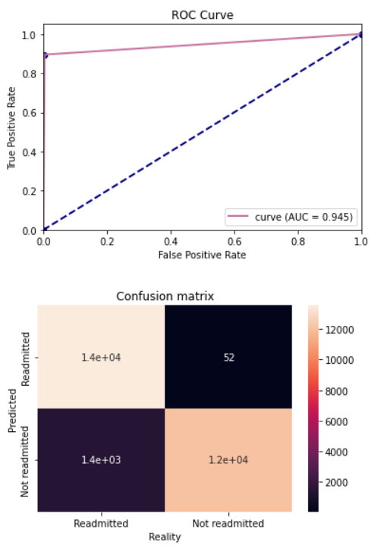
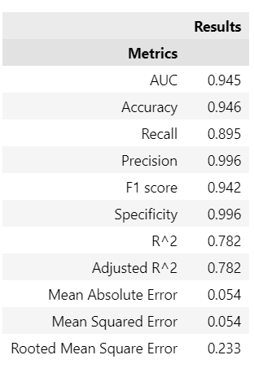
Modeling:
Results with Random Forest Classification

Slide 13
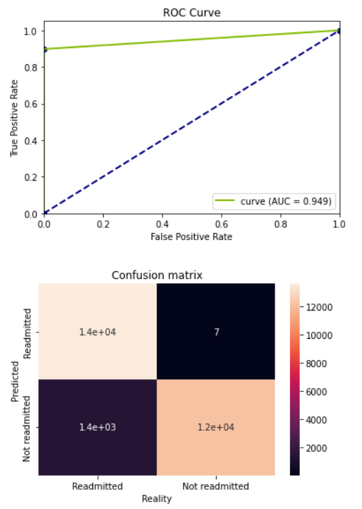
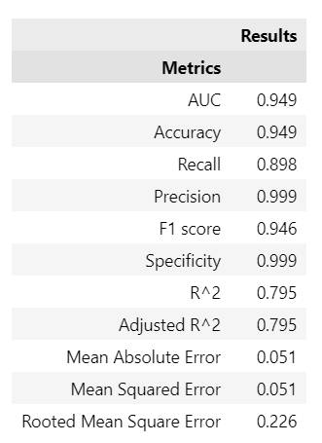
Modeling:
Results with XGBoost Classification

Slide 14
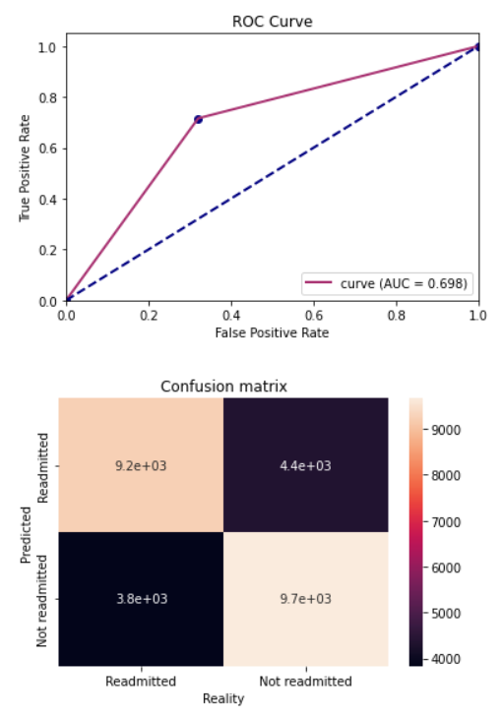
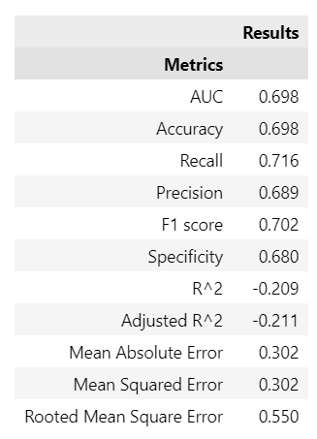
Modeling:
Results with Decision Tree Classification

Slide 15
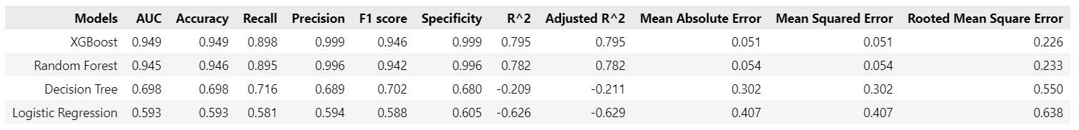
Modeling:
Global results

Slide 16
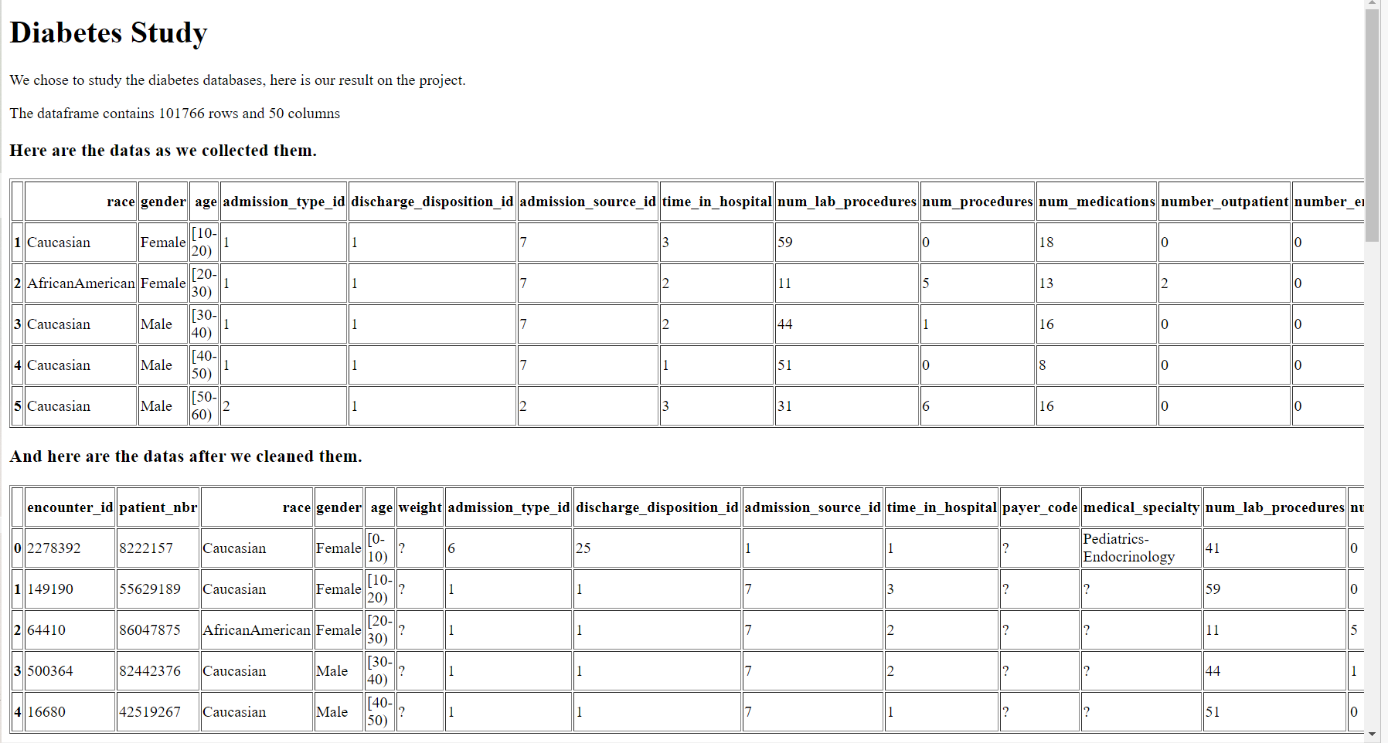
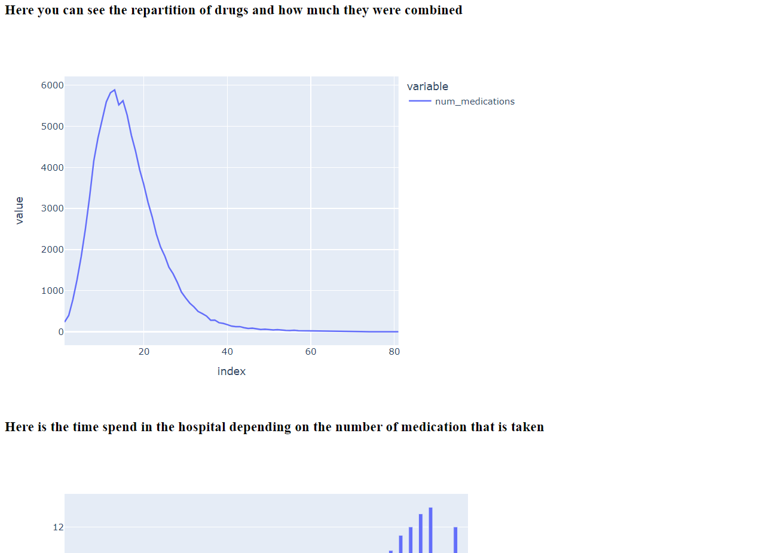
Django API:
The databases
Some graphs

Slide 17
The project:
How does it fit in the context
of our study?
Resume of all libraries use
In python during the semester
Use of models seen in machine learning class with a problematic
Observation of concept discovered
During soft skills sessions
A subject that could fit with
Problems of the medical sector

Slide 18
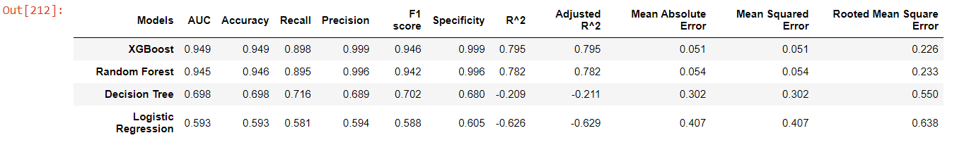
Conclusions:
Which lessons can we
Bring back from this study?
XGBoost allows us to predict the readmission of a patient depending on the drugs, age and admission with an accuracy of 94,9%.

